Slide 1

Case Study Analysis By Raman Deep Singh
Fox Brothers
IN PURSUIT OF MAKING AWESOME MOVIES

Slide 2
Business Problem
Defining Success
Dataset
Recomme-ndations
EDA
Models
Client Overview:
An American production house, Fox Brothers, has been in the movie business for several years. They are doing reasonably well and receive good feedback from both critics and audiences
Business Problem:
Like any other company, rising competition has made Fox Brothers to think about how to make better movies
In their “pursuit to make awesome movies” which is also their tagline, Fox wants us to help them identify and quantify the factors that drive the success or failure of a movie through data analytics
Assumption
All budget, revenue values are in the same currency, independent of the country in which the movie was made

Slide 3
Business Problem
Defining Success
Recomme-ndations
Dataset
EDA
Models
Defining Success:
Commercial Success
Gross Revenue and Budget are already included in the data set.
Additionally define:
Return on Investment (ROI): (Gross – Budget) / Budget
Success: ROI > 0 means Success (coded as 1) else Failure (coded as 0)
Why ROI?
ROI focuses on percentage returns and hence makes success comparable over time.
Critically Acclaimed
Being a production house, we want to make money but what is also important is appreciation of the movies. This is defined by Imdb Scores where many movies which fail at Box Office have high ratings.

Slide 4
Business Problem
Defining Success
Recomme-ndations
Dataset
EDA
Models
Given Dataset:
5043 observations
28 variables
14 numeric variables
14 non-numeric variables
Data Cleaning and Missing Value Treatment:
126 duplicate records were removed from 5043 observations to get 4917 observations
Gross is used to make ROI which is our dependent variable. 863 missing values for gross. These rows are removed to get 4054 rows.
Other columns containing missing values are imputed by using mean or median depending on which variable it is
Average ROI is 1.065. Budget for missing rows is imputed by dividing Revenue of that row by 1.065

Slide 5
Business Problem
Defining Success
Recomme-ndations
Dataset
EDA
Models
New Variable Creation
ROI, Success is added as described in previous slide
Genre of the movie is very important.
Separated all Genres from one text field so that they can be individually used in the model
26 dummy variables created from genre text field
No of genres is a new variable
No of keywords that were used to advertise the movie is also a new variable

Slide 6
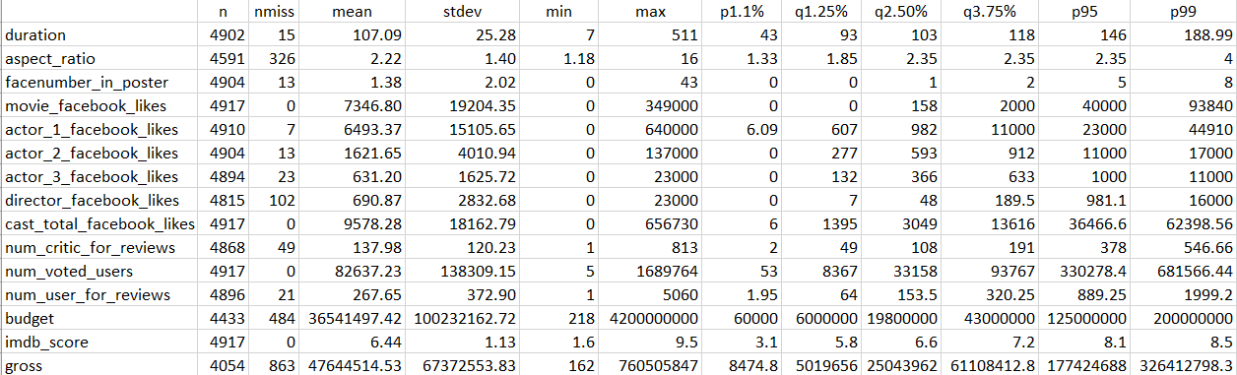
Business Problem
Defining Success
Recomme-ndations
Dataset
EDA
Models
Exploratory Data Analysis (all numerical variables):

Slide 7
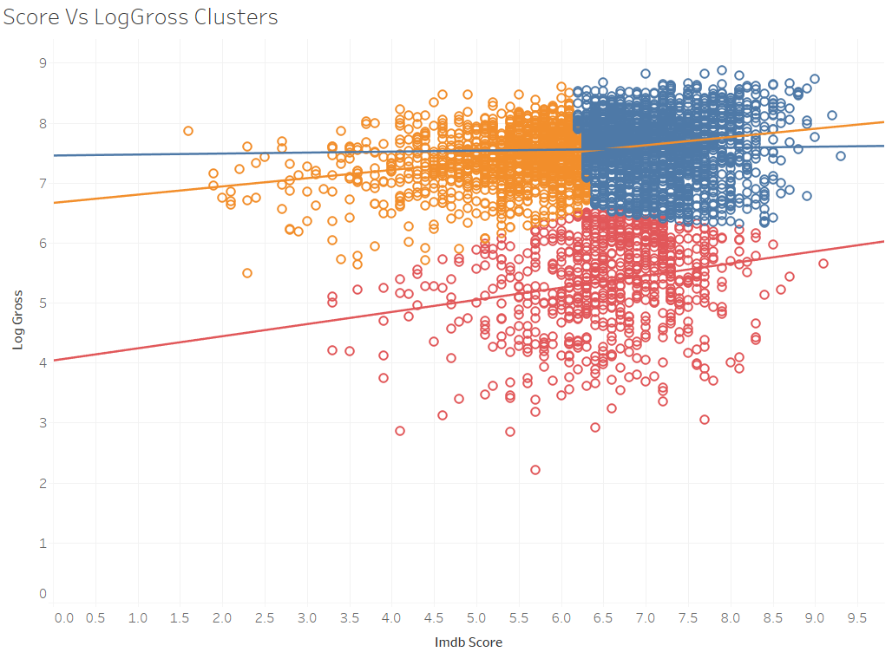
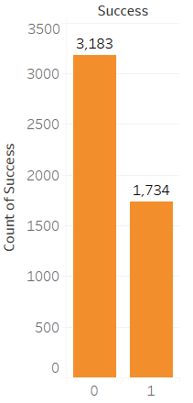
Business Problem
Defining Success
Recomme-ndations
Dataset
EDA
Models
Exploratory Data Analysis:

Slide 8
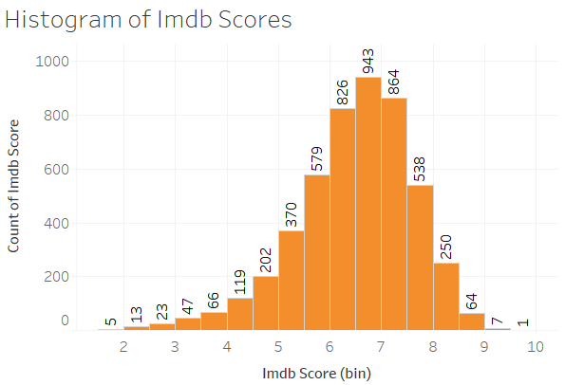
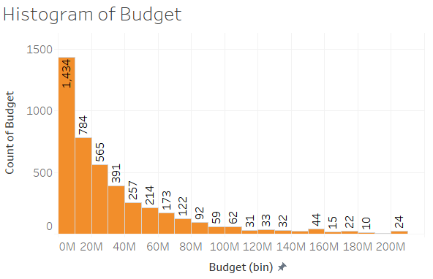
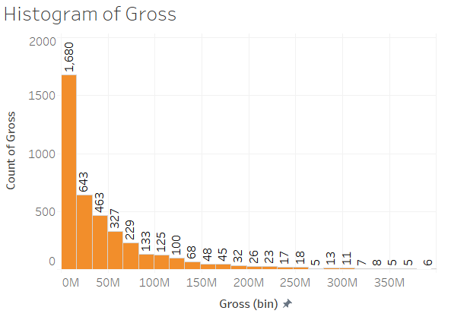
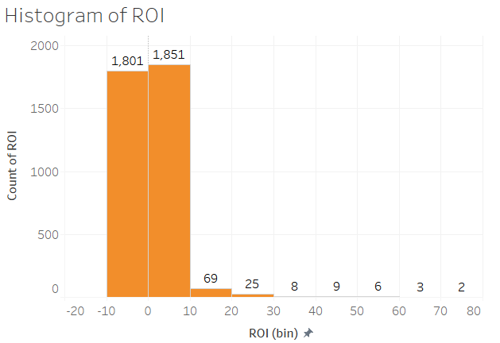
Business Problem
Defining Success
Recomme-ndations
Dataset
EDA
Models
Exploratory Data Analysis:

Slide 9
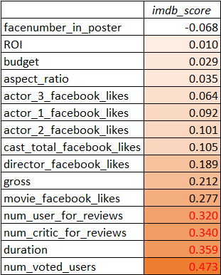
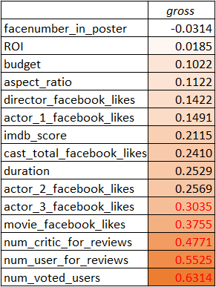
Business Problem
Defining Success
Recomme-ndations
Dataset
EDA
Models
Correlations:
Imdb_score and gross are positively correlated to most other indicators with num_voted_users showing high correlation with both of them

Slide 10
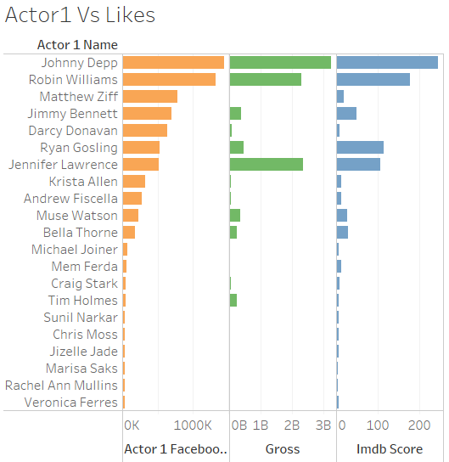
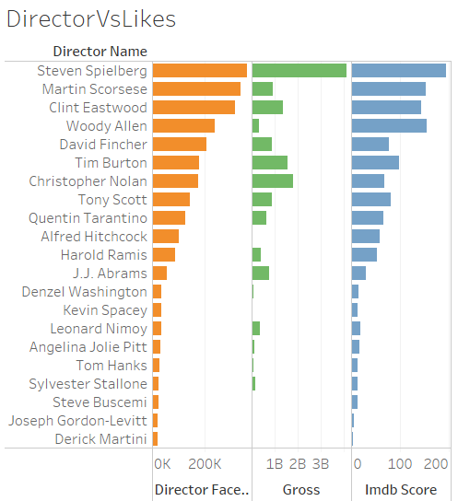
Business Problem
Defining Success
Recomme-ndations
Dataset
EDA
Models
Exploratory Data Analysis (breaking the myth):

Slide 11

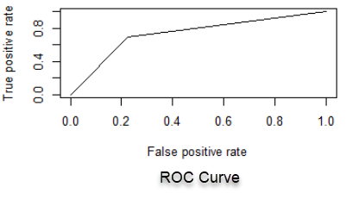

Business Problem
Defining Success
Recomme-ndations
Dataset
EDA
Models
Classification Problem
Dependent Binary Variable: ‘Success’ (Yes = 1, No = 0)
Logistic Regression
Accuracy = 0.7341

Slide 12
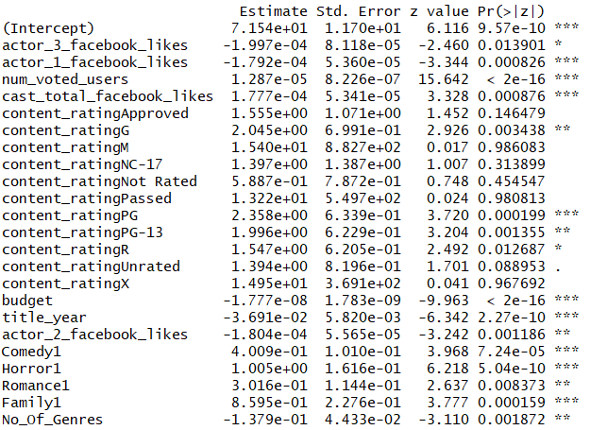
Business Problem
Defining Success
Recomme-ndations
Dataset
EDA
Models
Negative Impact
Facebook likes of actor are significant while director is not
A movie trying to cater to multiple genres is less likely to be successful
Positive Impact
Some Genres like (Comedy, Horror, Romance and Family) contribute to making successful movies
Number of users who rated the movie, Content Rating and total likes for the cast make the movie successful

Slide 13
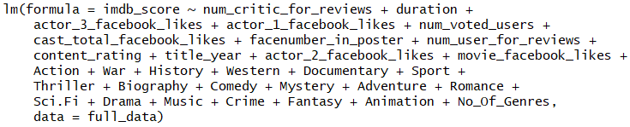
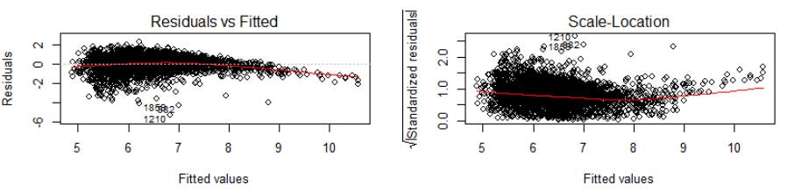
Business Problem
Defining Success
Recomme-ndations
Dataset
EDA
Models
Prediction Problem
Predict IMDB Score

Slide 14
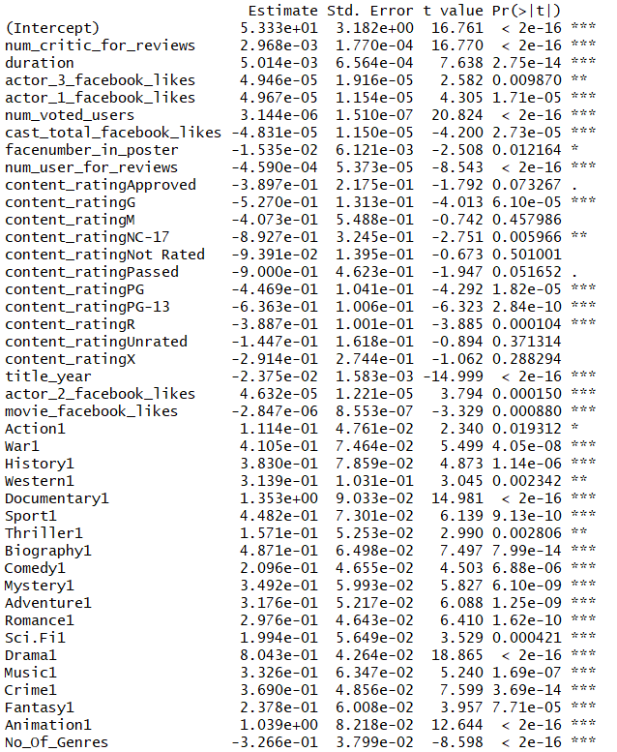
Business Problem
Defining Success
Recomme-ndations
Dataset
EDA
Models
Insights:
Actors are more important than directors and contribute positively to Imdb score
Genres like (Action, War, History, Western, Documentary, Sport, Thriller etc) are significant in making successful movies
If the movie covers more than one genre, its probability to have higher imdb decreases
Facebook likes of actor, complete cast and movie are significant
Number of reviews by critics and likes by users contribute positively.
Content Rating and Title_year is also important
Reviews by users impacts negatively

Slide 15
Business Problem
Defining Success
Recomme-ndations
Dataset
EDA
Models
Recommendations:
Actors are more important than directors
Focus on genres(comedy, romance, family) that contribute to the movie being successful
US is the biggest market and we should make movies catering to this audience
Movies made in English have a wide acceptability and so are likely to be more successful.
Do not make movies catering to more than one genre, its probability to be successful both in terms of commercial success and in terms of imdb score decreases

Slide 16
Thank you!
Questions?

Slide 17
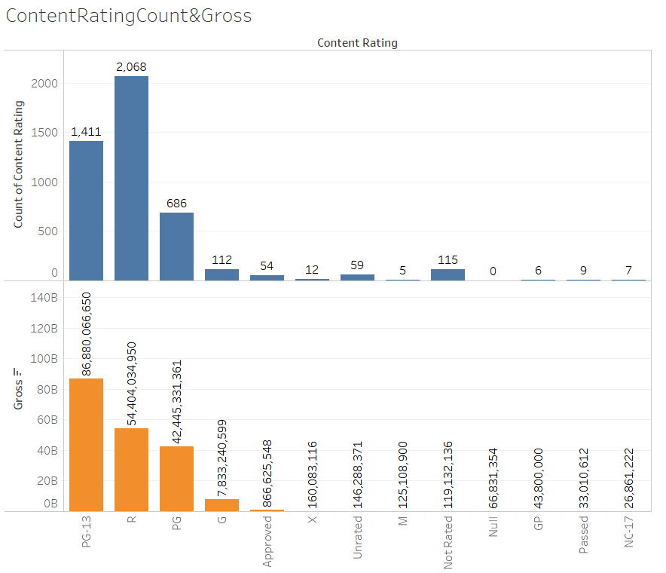
APPENDIX

Slide 18
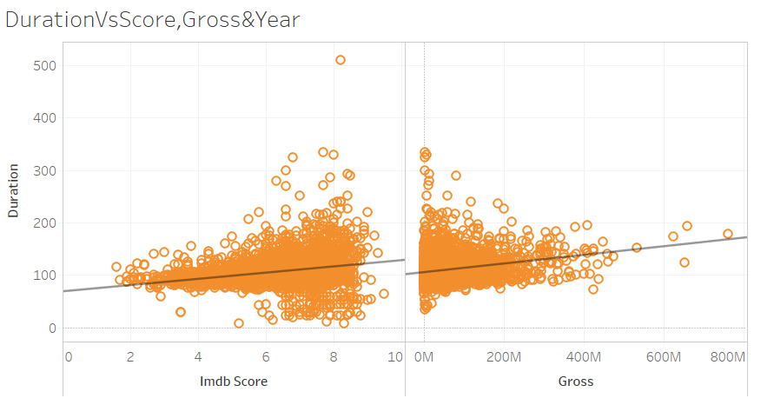
APPENDIX

Slide 19
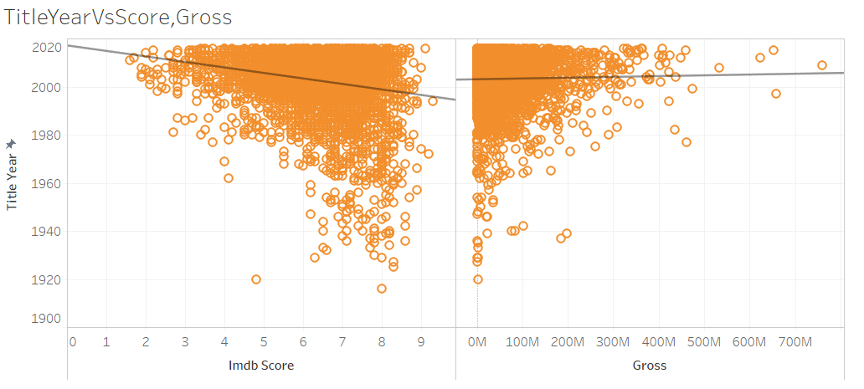
APPENDIX

